Slide 1
Bias in Psychological Measurement
Dr Julia Wolska

Slide 2
This Video
Statistical biases
Slope bias
Intercept bias
Differential Item Functioning
Bias from use of measurement

Slide 3
Statistical bias
Expected value of results differs from true underlying score
Systematic deviation from actual value

Slide 4
Distinction: Test bias and test fairness
Whether a test is biased is subject to “objective statistical indices that examine patterning of test scores for relevant test populations” (Gregory, 1996, p.263)
Whether test is fair depends on social values, ethical principles

Slide 5
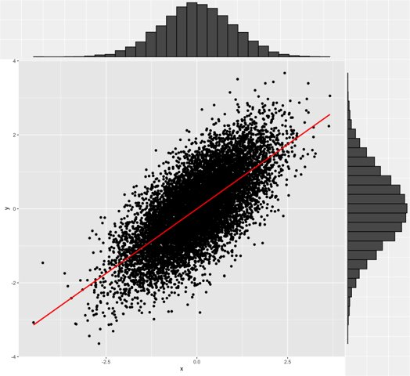
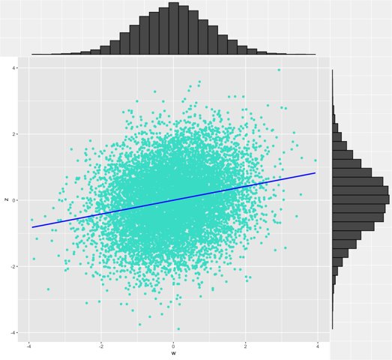
Slope bias
Group 1: r = 0.7
Group 2: r = 0.2

Slide 6
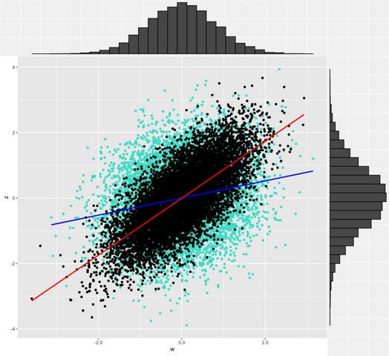
Slope bias

Slide 7
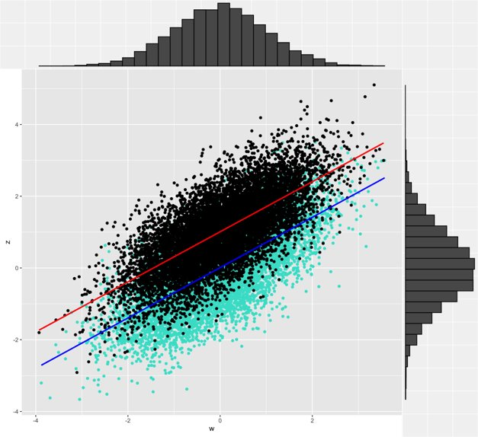
Intercept bias

Slide 8
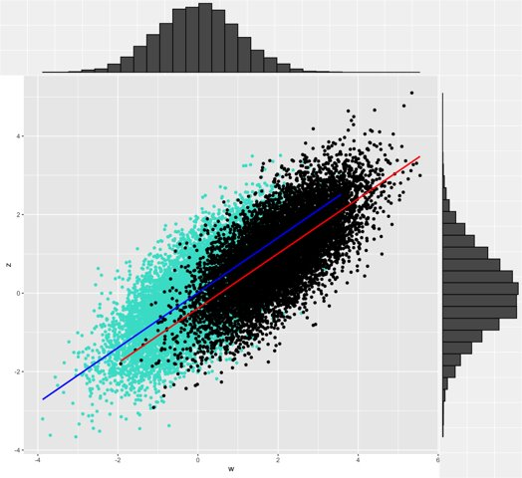
Intercept bias

Slide 9
Differential Item Functioning
Take samples from 2 groups with about same scores
Examine individual items for differences between 2 groups
If items function differently across different groups -> test bias
Items that show significant differences should be removed

Slide 10
Bias in risk assessment
Important to check assessment manual/ norm group!
Men over-represented in criminal populations
Most tests validated on adult males
Not predictive of females (and other genders) or juveniles (Ackerman, p90; Beech, Fisher, & Thornton, 2003)

Slide 11
Intelligence - ethnicity
Large debate about intelligence and invariance across racial and ethnic groups (see chapter 6, Kaplan and Saccuzzo; Ford, 2005)
Debate extends to forensic assessment
Clinical interviewing, diagnostic assessment and psychological testing in minority ethnic groups (Weiss, & Rosenfeld, 2012)

Slide 12
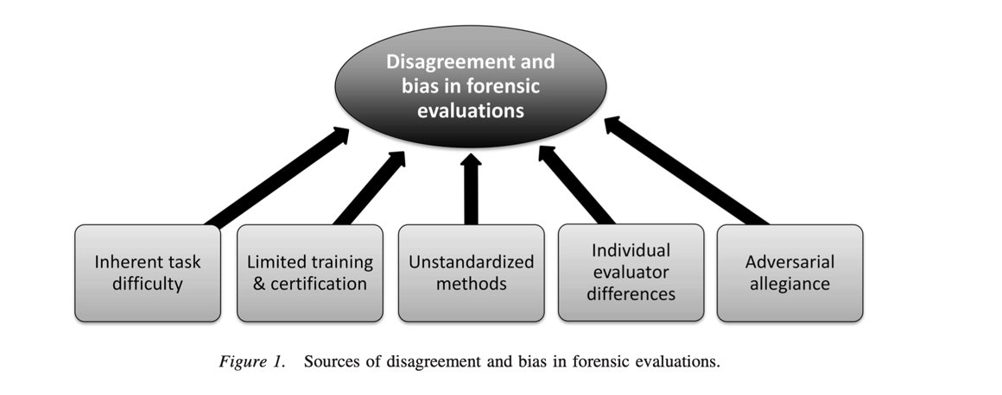
Sources of bias in forensic evaluations
Guarnera, Murrie, & Boccaccini (2017)

Slide 13
Reading
Books:
Ackerman – Chapter 1 – Forensic Specific introduction​
Kaplan and Saccuzzo – Chapter 6 (Bias)​
Articles:
Beech, A. R., Fisher, D. D., & Thornton, D. (2003). Risk assessment of sex offenders. Professional Psychology: Research and Practice, 34(4), 339-352.
Guarnera, L.A., Murrie, D.C., & Boccaccini, M.T. (2017). Why do forensic experts disagree? Sources of unreliability and bias in forensic psychology evaluations. Translational Issues in Psychological Science, 3(2), 143-152.
Weiss, R.A., & Rosenfeld, B. (2012). Navigating cross-cultural issues in forensic assessment: Recommendations for Practice. Professional Psychology Research and Practice, 43(3), 234-240.
Internet resources:
Ford, D.Y. (2005). Intelligence Testing and Cultural Diversity: Pitfalls and Promises. The National Research Center on the Gifted and Talented (NRC/GT). https://nrcgt.uconn.edu/newsletters/winter052/

